Slide 1
Service Learning
Workshop: November 22, 2019
New Mexico Highlands University
School of Education
Copyright, Paula Smith-Hawkins, LLC ®
Notes:
NOTE:
To change the image on this slide, select the picture and delete it. Then click the Pictures icon in the placeholder to insert your own image.

Slide 2
Our Workshop
How can Service Learning help our Students?
Different Methods for offering Service Learning: Curriculum Design
Cross-walking Service Learning and NMHU School of Education Traits

Slide 3
What to expect
LOGISTICS
Workshop runs from 1:00 p.m. to 4:00 p.m.
3 sections, as per NMHU questions
Final session ends with a Next Steps
Poll Everywhere App
Text this word: PAULASMITHHA218
To this phone number 22333
INTERACTIONS
Ask Questions!
Ground Rules?
Diversity
Leadership
Culturally inclusive
Authentic setting
Professionalism
Practice
Reflective practitioner
Knowledge

Slide 4
Introductions

Slide 5
Part I: What are the Benefits of Service Learning for students?
Service Learning Workshop
November 22, 2019
Notes:
NOTE:
To change the image on this slide, select the picture and delete it. Then click the Pictures icon in the placeholder to insert your own image.

Slide 6
Benefits of Service Learning for Students
Direct
Engage community
Different mechanisms for learning
Hands-on
Reflective
Life skills
Enhance resume’
Indirect
NM HED State goals
Link NMHU students to Workforce
Retention Strategy

Slide 7
Experiential Learning: The Research
American Association of Colleges & Universities:
*“High Impact Practices”
*HIP “Institute”
Service Learning, Community-Based Learning
In these programs, field-based “experiential learning” with community partners is an instructional strategy—and often a required part of the course.
The idea is to give students direct experience with issues they are studying in the curriculum and with ongoing efforts to analyze and solve problems in the community.
A key element in these programs is the opportunity students have to both apply what they are learning in real-world settings and reflect in a classroom setting on their service experiences.
These programs model the idea that giving something back to the community is an important college outcome, and that working with community partners is good preparation for citizenship, work, and life. (AACU.org)

Slide 8
Experiential Learning Theory Made Simple

Slide 9
Kolb’s Model of Experiential Learning
Concrete Experience
Describe your experience.
What did you do? What actions did you take?
Common verbs: worked, created, prepared, implemented, conducted, produced
Active Experimentation
What happened as a result of your experience, reflection, and learning?
How did you apply your learning to future situations?
Common verbs: used, updated, applied, tried, implemented, changed
Reflective Observation
What did you notice and observe about the experience?
Common verbs: observed, watched, noticed, saw thought, discovered
Abstract Conceptualization
What rules, theories, and concepts apply to this situation?
Common verbs: concluded, theorized, found, realized, deduced, learned

Slide 10
Work Education Experience
Internship | Practicum | Work Study
Cooperative Education | Externships | Apprenticeships
Service Learning | Incubator Experience | Field Experience
Job Shadow | Clinical Experience | Volunteerism

Slide 11
Baseline Definition of Work Education Experience
An academic-based, temporary hands-on work-experience with an industry partner related to a student’s field of study that complements classroom theory by putting theory into practice and allows students to reflect on their experience. (Furco, 1996)

Slide 12
73% of Employers believe:
“Requiring college students to complete a significant applied Learning project before graduation would improve the quality of their preparation for careers.”
60% of Employers indicated:
“They would be more likely to consider a candidate for full-time employment if he/she had completed an internship.”
Source:
Hart Research Associates in conjunction with the American Association
of Colleges and Universities, 2015

Slide 13
Starting Points: Basic Definitions of Service Learning
Service Learning is an established type of experiential learning in higher education.
Service Learning is a form of experiential learning and is designed to enhance and enrich student learning of course material. It directly engages the learner in the discipline, resulting in richer learning experience.
Student Learning Outcomes for specific courses are met through engagement in active learning.
Service Learning is “the combination of community service and classroom instruction, with a focus on critical, reflective thinking as well as personal and civic responsibility.” (AACC).
Students typically work with non-profit agencies, for credit.

Slide 14
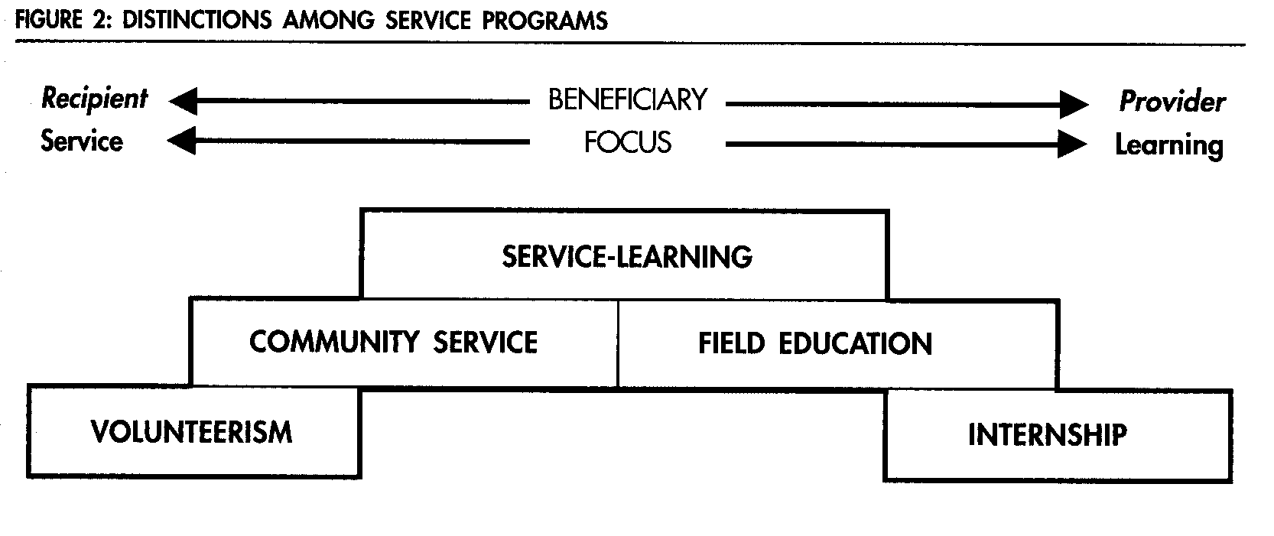
Furco defines Service Learning (1996)

Slide 15
Who Benefits and What is the Focus of Service Learning
Primary Beneficiary:
Primary Focus:
The Community
Student Learning

Slide 16
Types of Service Learning
Direct Student Learning
Person-to-person, face-to-face service projects in which the students’ service directly impacts individuals who receive the service from the students. Examples include:
Conducting art/music/dance lessons for youth
Giving presentations on violence and drug prevention
Helping in a homeless shelter
Creating life reviews for hospice patients
Indirect Student Learning
Working on broad issues, environmental projects, or community development – projects that have clear benefits to the community or environment, but not necessarily to individually identified people with whom the students are working. Examples include:
Compiling a town history
Restoring historic structures or building low-income housing
Removing invasive plants and restoring ecosystems in preserve areas for public use
Research Based Student Learning
Gathering and presenting information on areas of interest and need – projects that find, gather, and report on information that is needed. Examples include:
Writing a guide on available community services and translating it into Spanish and other languages of new residents
Conducting longitudinal studies of local bodies of water; water testing for local residents
Gathering information and creating brochures or videos for non-profit or government agencies
Educating others about topics of public interest – projects that aim to create awareness and action on some issue that impacts the community
Planning and putting on public forums on topics of interest in the community
Conducting public information campaigns on topics of interest or local needs
Advocacy Student Learning

Slide 17
Student Learning Outcomes are the Key to Successful Service Learning
We consider the Student Learning Outcomes, Program Competencies, and Objectives.
SLOs are central to a success Service Learning curriculum and structure.
SLOs should be a starting and ending point for the Service Learning Experience.
Linking SLOs to course activities, and appropriately assessing the SLOs is the toughest part of the process for faculty (or it should be!)

Slide 18
SLO Charting
SLO | Activity Match to SLO | Assessment/Measure
SOC 1110 Apply the sociological imagination to illustrate how “personal troubles” relate to “public issues” | Forage Farmers, a Vet’s organization | Reflective Essay, using C. Wright Mill’s framework of the Sociological Imagination
PSY 2220 Stats | Run statistical analysis of different types of garbage in Mt. Recyclemore | Create tables and graphs to summarize central tendency and variability in given datasets
ENG 2219 Technical Writing | Evaluate manuals and know principles for creating a manual then, created their own manual on verimiculture | Final paper (manual) against regular grading rubric

Slide 19
Exercise
Mind Map:
Think of one (1) student learning outcome or objective from one of the courses you teach.
Free write ideas (try for 3) of activities involving Service Learning in that class.
How would you ensure that your activity is aligned with the SLO?
How would you assess that the student met the SLO you identified?
How would you ensure that your assessment is valid?

Slide 20
Reflection: “Word Cloud” Exercise
Poll Everywhere App
Text to 22333
PAULASMITHHA218 to join
Or use Poll Everywhere on you phone
https://www.polleverywhere.com/free_text_polls/t2JfOK9zNzdPxwA

Slide 21
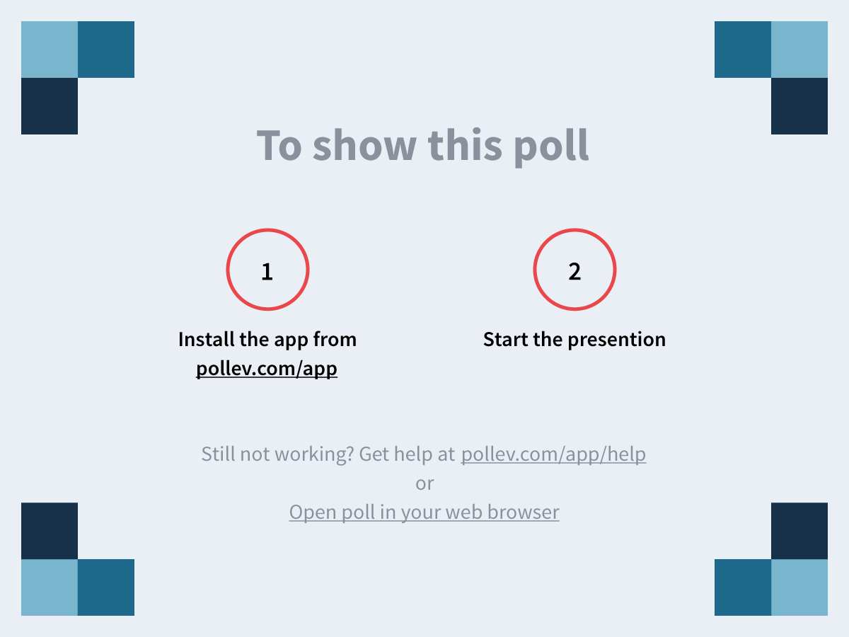
Notes:
How can our students benefit from Service Learning? https://www.polleverywhere.com/free_text_polls/t2JfOK9zNzdPxwA

Slide 22
Self-Assessment
1) Do you think you can explain what Service Learning is to a colleague?
2) What about Service Learning is most confusing to you?

Slide 23
Brief Break?
Instructor Lissa Knudsen uses the “experience” of Service Learning to provide material for her Public Speaking students’ final speech. (Graded using standard rubric.)

Slide 24
Part II: Service learning course components
Service Learning Workshop
November 22, 2019

Slide 25
Different Ways to Offer Service Learning: Modes 1, 2, & 3

Slide 26
Service Learning MODE 1: Independent Credit - Integrated
Independent Credit - Integrated
Characteristics
1 Credit (Tuition Rate Applies)
Embedded within an anchor course
Not always career or degree related
Always connected to SLOs of the anchor course
Appears on Transcript
20-35 hours of service in one semester
Elective
OR
May be required for specific programs

Slide 27
Service Learning MODE 1: Independent Credit - Linked
Independent Credit - Linked
Linked to specific courses
*Identified by faculty curriculum experts.
Characteristics
1 credit
20-35 contact hours
Included in Schedule as “Plus” or “lab”
Embedded in degree
Faculty/Department agreement on SLOs
Even shared assignments

Slide 28
Service Learning MODE 2: Embedded
Embedded
Course Requirement
Embedded in Curriculum
Characteristics
20-35 contact hours
Not transparent in schedule
Note in Catalog
Explicit in Master Syllabi
Faculty/Department agreement on SLOs
Even shared assignments

Slide 29
Service Learning MODE 3: Unique Certificate
Unique Certificate
Not linked to any specific course
Characteristics
No tuition
20-35 contact hours
Harder to enforce for degree completion
Separate process, database to hold records
Must create unique artifact (certificate itself)
Staff management of processes, including vetting organizations

Slide 30
Overview
Mode 1: Independent | Mode 2: Embedded | Mode 3: Unique Certificate
Tuition | Tuition | No cost to student
Faculty Led & Managed | Dept. Led & Managed | Staff Support
Flexibility & Autonomy | Flexibility | Policy
Not easily tied to degree | Tied to degree | Not tied to degree
Easy to transcript | Transcripted, not transparent | Unique certificate
Faculty resources needed | Department Resources | No faculty burden, cost in staff
Faculty responsible for vetting agencies & record keeping | Department responsible for vetting agencies & record keeping | Staff maintain database, vet agencies

Slide 31
Reflection on Curriculum Design
Poll Everywhere App
Text to 22333
PAULASMITHHA218 to join
https://www.polleverywhere.com/free_text_polls/t2JfOK9zNzdPxwA

Slide 32
Notes:
Which Mode will be the most successful at NMHU? https://www.polleverywhere.com/ranking_polls/6TWwsLufJi6avwV

Slide 33
Think Pair-Square Assessment
1) What are the strengths and weaknesses of each modality?

Slide 34
Break?
Instructor Ying Xu had her Composition students participate in a slogan competition for an immigration advocacy group. The students wrote “pitches” for their respective slogans, and then created tee-shirts using the winning slogan.

Slide 35
Part III: NMHU Traits & Assessment of service Learning
Service Learning Workshop
November 22, 2019

Slide 36
New Mexico Highlands University, School of Education: Traits
Diversity
Leadership
Culturally inclusive
Authentic setting
Professionalism
Practice
Reflective practitioner
Knowledge

Slide 37
Diversity
Are we exposing students to diverse experiences, agencies, and populations?
Think about how we create opportunities, share, and vet agencies.

Slide 38
Leadership
What type of “next steps” do we ask of students in their final reflection on Service Learning?
How can we use Service Learning reflections to measure leadership?

Slide 39
Assessment Framework Example: Civic Minded Graduate Domains (Hatcher& Studer, 2015)
Knowledge: Volunteer opportunities and nonprofit organizations: understanding of ways to contribute to society, particularly through voluntary service, and including knowledge of the nonprofit sector. Academic knowledge and technical skills: understanding of how knowledge and skills in at least one discipline are relevant to addressing issues in society. Contemporary social issues: understanding of current events and the complexity of issues in modern society locally, nationally, or globally.
Skills: Communication and listening: ability to communicate (written and oral) with others, as well as listening to divergent points of view. Diversity: understanding the importance of, and the ability to work with, others from diverse backgrounds; also appreciation of and sensitivity to diversity in a pluralistic society. Consensus building: ability to work with others, including those with diverse opinions, and work across difference to come to an agreement or solve a problem
Dispositions: Valuing community engagement: understanding the importance of serving others, and being actively involved in communities to address social issues. Self-Efficacy: having a desire to take personal action, with a realistic view that the action will produce the desired results. Social trustee of knowledge: feeling a sense of responsibility and commitment to use the knowledge gained in higher education to serve others.

Slide 40
Culturally Inclusive
Challenge:
Think broadly about Service Learning Experiences.
* Can we consider opportunities on our campus for Service Learning?
* How do we feel about Service Learning within students’ own communities?

Slide 41
Authentic Setting
Service Learning meets this goal naturally.
We got this!

Slide 42
Professionalism
What are our rubrics for this in Service Learning?
Logging time
Punctuality
Engagement
Reflections
*Student Code of Conduct*

Slide 43
Practice
Thinking carefully about what activities are appropriate for our courses.
Alignment is key
*Shared ‘site’ for faculty exchange of ideas, information on sites, experiences.

Slide 44
Reflective Practitioner
Reflection is integral to Service Learning!
-Journal
-Interview
-Response Paper
-”What I would do differently” essay
*How did you meet the student learning outcome?
*What tasks did you do to meet this outcome?
*What is the impact of what you learned?
How does your service learning experience relate to the learning objectives of the course?
What did you observe?
What did you learn?
How has the experience affected you (how did you feel)?
What has been particularly rewarding about your service?
What would you change about your service learning agency site that would make it more meaningful for you or other service learning students?
What have you learned about yourself?
Has your service learning experience influenced your career choice in anyway?
What have you learned about your community?
What values, opinions, beliefs have changed?
How has your willingness to help others changed?

Slide 45
Knowledge
Again, linking to Student Learning Outcomes of Course and Program.
“High Impact Practice” for learning.

Slide 46
One Example of a Program Level Assessment: Portfolio to Assess Service Learning
Course(s) Information
Learning Narrative Introduction
Learning Narrative
Student Learning Outcomes (SLOs) = Section headers
Documentation
Referenced in narrative
Can include: letter of verification from an expert or employer attesting to learning outcomes, PowerPoint presentations, work products (reports, spreadsheets, websites, strategic plans, etc.), audio or video recordings of the student performing specific tasks/skills
Learning Narrative Conclusion

Slide 47
Assessment Plan: Considerations
By Course
Repository: Where to keep data? IR?
Shared space for reflection on SLOs
Regular review cycle?
Feedback loops from Chairs, Deans
Per Program
Repository
Responsibility lies with Chair? Dean?
Committee to evaluate and report
Measurement of student experience?
Qualitative (surveys, interviews)
Quantitative (retention & grade data)

Slide 48
Exercise: 3 Minute Paper
What do you NOT want to happen with assessment of Service Learning?
Text to 22333
PAULASMITHHA218
Type in your answer

Slide 49
Notes:
What do you NOT want to happen with assessment of Service Learning? https://www.polleverywhere.com/free_text_polls/3hfyw0rFhw9VGnL

Slide 50
Decisions going Forward: Faculty Impact Framework
Curriculum choice (See Next Steps)
Faculty Checklist: How to?
Advocate or Liaison
Vetting agencies, feedback
Review process for feedback, quality control
Form completion
Record Retention
Trouble-shooting
Staff support
Registration

Slide 51
Decisions going Forward: Student Impact Framework
Agency selection (degree of choice)
Forms (logs)
Fees
Checklist for students: How to?
Student Conduct & Student Protections

Slide 52
Next Steps for this Team: Service Learning Action Plan
1) Consensus point: Concise definitions of Work Education Experience?
2) Decision point: Which type of curricular offering Service Learning will be at NMHU?
3) Decision point: Assessment methodology?
4) Decision point: Would we have a committee (or Chairs) to review projects against our Traits?
5) Consensus point: What are our feedback loops?

Slide 53
Final Q & A
What do we need to move forward?

Slide 54
A Quick Test
Socrative.com
PAULA 1027

Slide 55
References
AACU “High Impact Practices” www.aacu.org’
Al Barwani, T., Al-Mekhlafi, A., & Nagaratnam, R. P., (2013). Service-learning might be the key: Learning from the challenges and implementation strategies in EFL teacher education in Oman. International Journal of Instruction, 6(2). pp.109-130.
Campus Compact, (2014). Educating communities: building communities. Retrieved from www.compact.org
Dunkel, F.V., Shams, A. N., & George, C.M. (2011). Expansive collaboration: A model for transformed classrooms, community-based research, and serviçe-learning, NACTA Journal, p. 65-75.
Eyler, J. “Reflection: Linking Service and Learning—Linking Students and Communities,” Journal of Social Issues, Vol. 58, No. 3 2002, pp. 517-534.
Felton, P, Clayton, P. “Service Learning”, in New Directions for Teaching and Learning, no. 128 Winter, 2011. Wiley online.
Hatcher, J., Studer, M. “Service Learning and Philanthropy”, Implications for Course Design”, Theory into Practice, 54: 11-19, 2015. Ohio State University.
Hemer, K., R. Reason & R. Ryder. “Factors Shaping Student Perceptions of Campus Climate for Civic Learning and Engagement”; (2019) Innovation in Research & Education.
Scott, K., & Graham, J. (2015). Service-learning. Journal of Experiential Education, 38(4).
Shaw, S. (2013). Service learning in interpreter education : Strategies for extending student involvement in the deaf community. Washington, D.C.: Gallaudet University Press. (2013). Retrieved November 18, 2019

Slide 56
Contact me
PaulaSmithHawkinsPhD.com

